Slide 1
Data Mining
Practical Machine Learning Tools and Techniques
Slides for Chapter 7 of Data Mining by I. H. Witten, E. Frank and
M. A. Hall

Slide 2
Data transformations
Attribute selection
  Scheme-independent, scheme-specific
Attribute discretization
  Unsupervised, supervised, error- vs entropy-based, converse of discretization
Projections
  Principal component analysis, random projections, partial least-squares, text, time series
Sampling
  Reservoir sampling
Dirty data
  Data cleansing, robust regression, anomaly detection
Transforming multiple classes to binary ones
  Simple approaches, error-correcting codes, ensembles of nested dichotomies
Calibrating class probabilities

Slide 3
Just apply a learner? NO!
Scheme/parameter selection
treat selection process as part of the learning process
Modifying the input:
  Data engineering to make learning possible or easier
Modifying the output
  Re-calibrating probability estimates

Slide 4
Attribute selection
Adding a random (i.e. irrelevant) attribute can significantly degrade C4.5’s performance
  Problem: attribute selection based on smaller and smaller amounts of data
IBL very susceptible to irrelevant attributes
  Number of training instances required increases exponentially with number of irrelevant attributes
Naïve Bayes doesn’t have this problem
Relevant attributes can also be harmful

Slide 5
Scheme-independent attribute selection
Filter approach: assess based on general characteristics of the data
One method: find smallest subset of attributes that separates data
Another method: use different learning scheme
  e.g. use attributes selected by C4.5 and 1R, or coefficients of linear model, possibly applied recursively (recursive feature elimination)
IBL-based attribute weighting techniques:
  can’t find redundant attributes (but fix has been suggested)
Correlation-based Feature Selection (CFS):
  correlation between attributes measured by symmetric uncertainty:
  goodness of subset of attributes measured by (breaking ties in favor of smaller subsets):

Slide 6
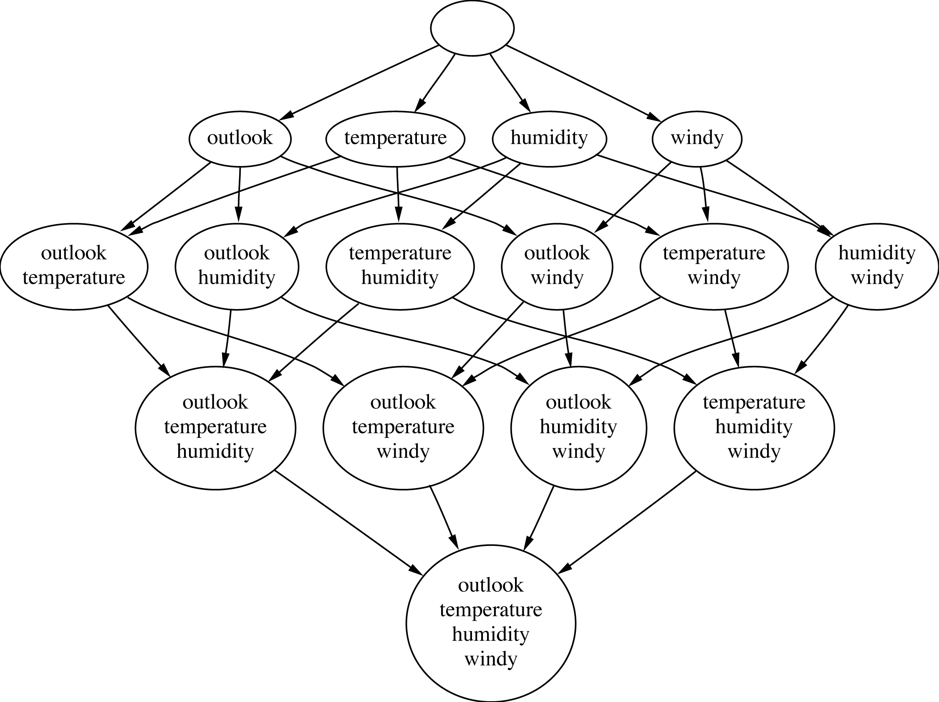
Attribute subsets for weather data

Slide 7
Searching attribute space
Number of attribute subsets is
exponential in number of attributes
Common greedy approaches:
  forward selection
  backward elimination
More sophisticated strategies:
  Bidirectional search
  Best-first search: can find optimum solution
  Beam search: approximation to best-first search
  Genetic algorithms

Slide 8
Scheme-specific selection
Wrapper approach to attribute selection
Implement “wrapper” around learning scheme
  Evaluation criterion: cross-validation performance
Time consuming
  greedy approach, k attributes ⇒ k² × time
  prior ranking of attributes ⇒ linear in k
Can use significance test to stop cross-validation for subset early if it is unlikely to “win” (race search)
  can be used with forward, backward selection, prior ranking, or special-purpose schemata search
Learning decision tables: scheme-specific attribute selection essential
Efficient for decision tables and Naïve Bayes

Slide 9
Attribute discretization
Avoids normality assumption in Naïve Bayes and clustering
1R: uses simple discretization scheme
C4.5 performs local discretization
Global discretization can be advantageous because it’s based on more data
Apply learner to
  k -valued discretized attribute or to
  k – 1 binary attributes that code the cut points

Slide 10
Discretization: unsupervised
Determine intervals without knowing class labels
  When clustering, the only possible way!
Two strategies:
  Equal-interval binning
  Equal-frequency binning
  (also called histogram equalization)
Normally inferior to supervised schemes in classification tasks
  But equal-frequency binning works well with naïve Bayes if number of intervals is set to square root of size of dataset
  (proportional k-interval discretization)

Slide 11
Discretization: supervised
Entropy-based method
Build a decision tree with pre-pruning on the attribute being discretized
  Use entropy as splitting criterion
  Use minimum description length principle as stopping criterion
Works well: the state of the art
To apply min description length principle:
  The “theory” is
    the splitting point (log₂[N – 1] bits)
    plus class distribution in each subset
  Compare description lengths before/after adding split

Slide 12
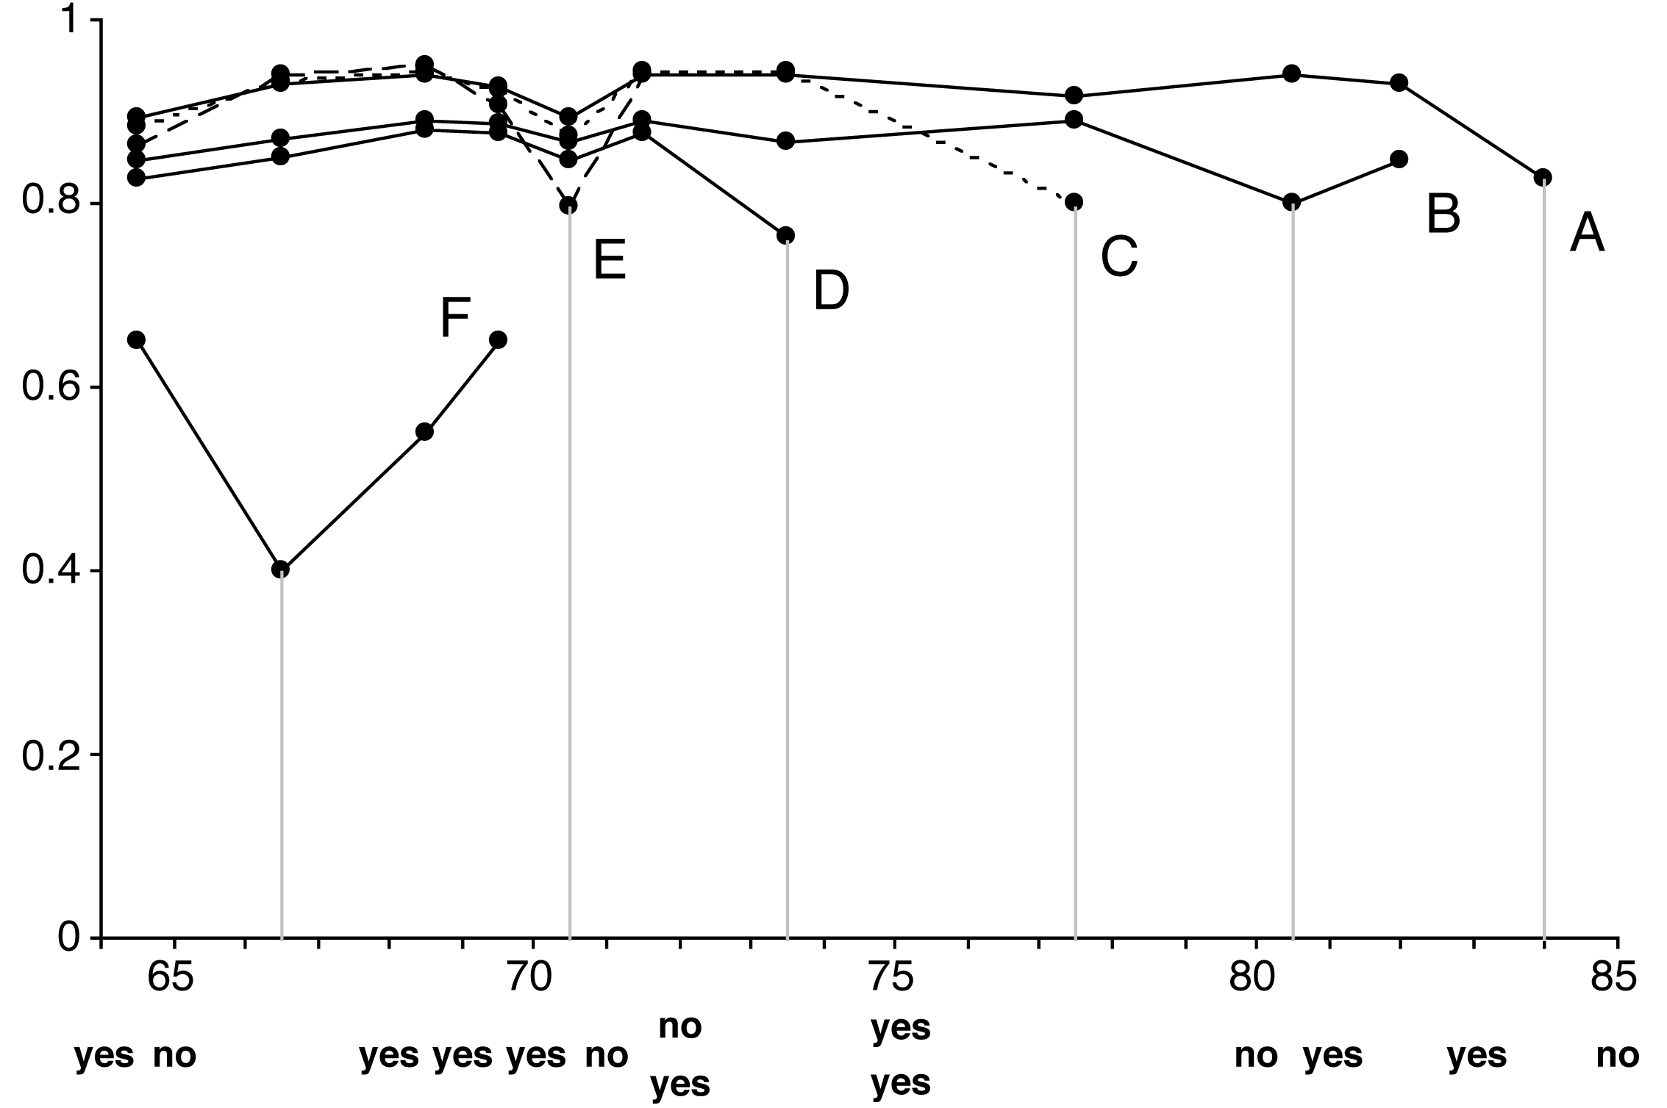
Example: temperature attribute
Temperature
64 65 68 69 70 71 72 72 75 75 80 81 83 85
Play
Yes No Yes Yes Yes No No Yes Yes Yes No Yes Yes No

Slide 13
Formula for MDLP
N instances
  Original set: k classes, entropy E
  First subset: k₁ classes, entropy E₁
  Second subset: k₂ classes, entropy E₂
Results in no discretization intervals for temperature attribute

Slide 14
Supervised discretization: other methods
Can replace top-down procedure by bottom-up method
Can replace MDLP by chi-squared test
Can use dynamic programming to find optimum k-way split for given additive criterion
  Requires time quadratic in the number of instances
  But can be done in linear time if error rate is used instead of entropy

Slide 15
Error-based vs. entropy-based
Question:
could the best discretization ever have two adjacent intervals with the same class?
Wrong answer: No. For if so,
  Collapse the two
  Free up an interval
  Use it somewhere else
  (This is what error-based discretization will do)
Right answer: Surprisingly, yes.
  (and entropy-based discretization can do it)

Slide 16
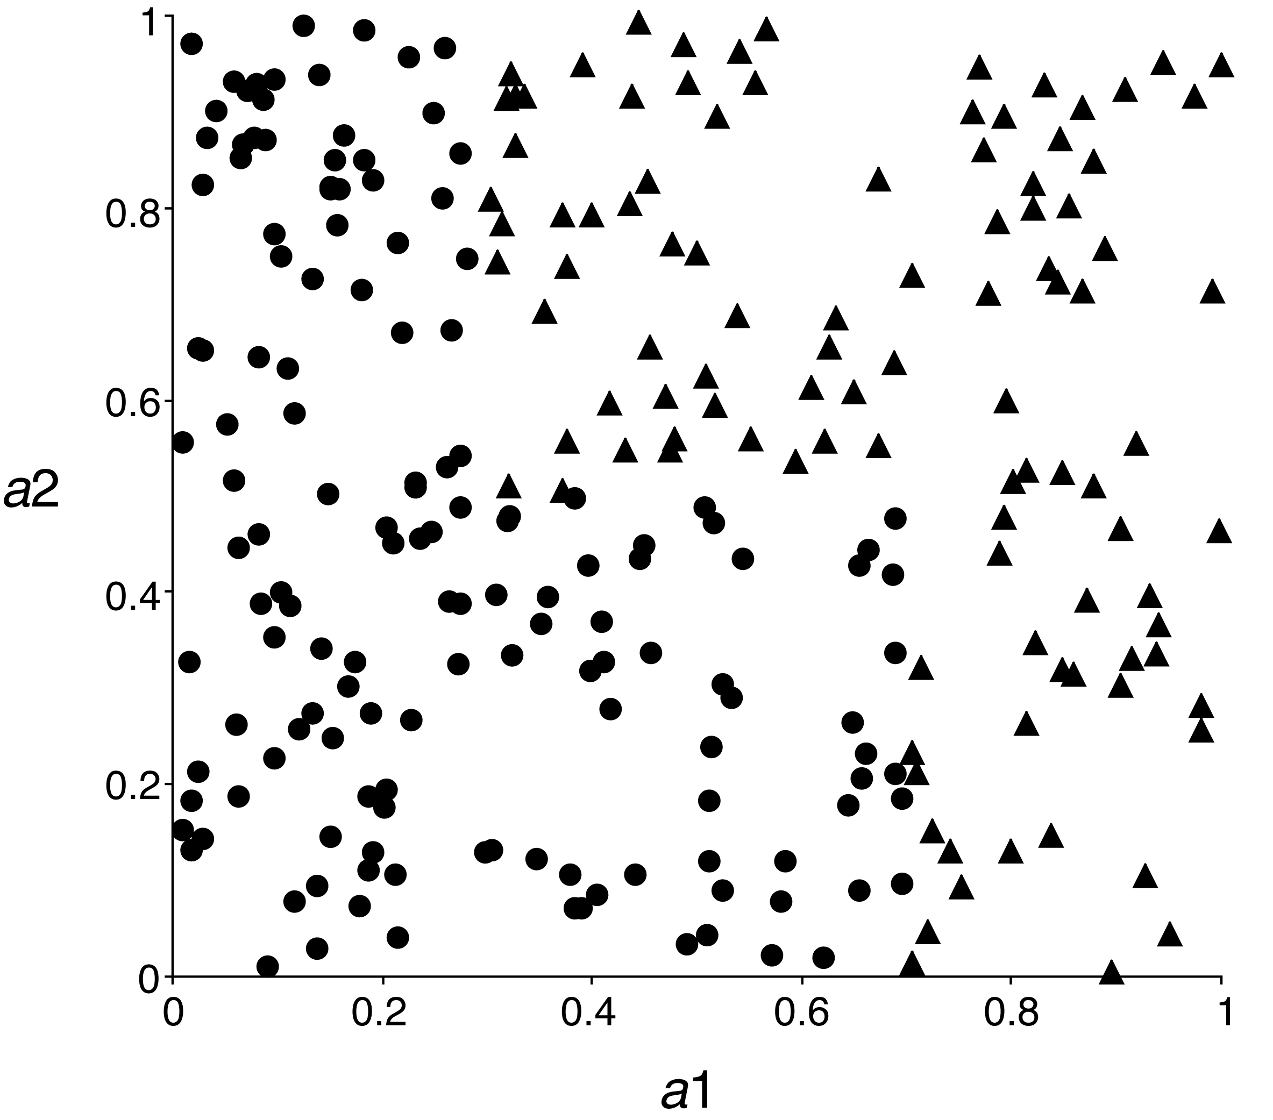
Error-based vs. entropy-based
A 2-class,
2-attribute problem
Entropy-based discretization can detect change of class distribution

Slide 17
The converse of discretization
Make nominal values into “numeric” ones
Indicator attributes (used by IB1)
  Makes no use of potential ordering information
Code an ordered nominal attribute into binary ones (used by M5’)
  Can be used for any ordered attribute
  Better than coding ordering into an integer (which implies a metric)
In general: code subset of attribute values as binary

Slide 18
Projections
Simple transformations can often make a large difference in performance
Example transformations (not necessarily for performance improvement):
  Difference of two date attributes
  Ratio of two numeric (ratio-scale) attributes
  Concatenating the values of nominal attributes
  Encoding cluster membership
  Adding noise to data
  Removing data randomly or selectively
  Obfuscating the data

Slide 19
Principal component analysis
Method for identifying the important “directions” in the data
Can rotate data into (reduced) coordinate system that is given by those directions
Algorithm:
  Find direction (axis) of greatest variance
  Find direction of greatest variance that is perpendicular to previous direction and repeat
Implementation: find eigenvectors of covariance matrix by diagonalization
  Eigenvectors (sorted by eigenvalues) are the directions

Slide 20
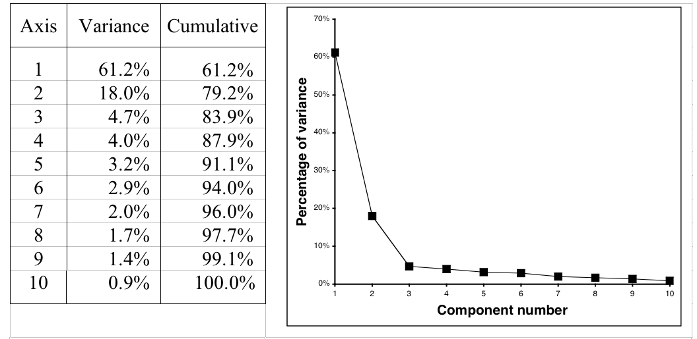
Example: 10-dimensional data
Can transform data into space given by components
Data is normally standardized for PCA
Could also apply this recursively in tree learner

Slide 21
Random projections
PCA is nice but expensive: cubic in number of attributes
Alternative: use random directions (projections) instead of principle components
Surprising: random projections preserve distance relationships quite well (on average)
  Can use them to apply kD-trees to high-dimensional data
  Can improve stability by using ensemble of models based on different projections

Slide 22
Partial least-squares regression
PCA is often a pre-processing step before applying a learning algorithm
  When linear regression is applied the resulting model is known as principal components regression
  Output can be reexpressed in terms of the original attribues
Partial least-squares differs from PCA in that it takes the class attribute into account
  Finds directions that have high variance and are strongly correlated with the class

Slide 23
Algorithm
Start with standardized input attributes
Attribute coefficients of the first PLS direction:
  Compute the dot product between each attribute vector and the class vector in turn
Coefficients for next PLS direction:
  Original attribute values are first replaced by difference (residual) between the attribute's value and the prediction from a simple univariate regression that uses the previous PLS direction as a predictor of that attribute
  Compute the dot product between each attribute's residual vector and the class vector in turn
Repeat from 3

Slide 24
Text to attribute vectors
Many data mining applications involve textual data (eg. string attributes in ARFF)
Standard transformation: convert string into bag of words by tokenization
  Attribute values are binary, word frequencies (fij), log(1+fij), or TF × IDF:
Only retain alphabetic sequences?
What should be used as delimiters?
Should words be converted to lowercase?
Should stopwords be ignored?
Should hapax legomena be included? Or even just the k most frequent words?

Slide 25
Time series
In time series data, each instance represents a different time step
Some simple transformations:
  Shift values from the past/future
  Compute difference (delta) between instances (ie. “derivative”)
In some datasets, samples are not regular but time is given by timestamp attribute
  Need to normalize by step size when transforming
Transformations need to be adapted if attributes represent different time steps

Slide 26
Sampling
Sampling is typically a simple procedure
What if training instances arrive one by one but we don't know the total number in advance?
  Or perhaps there are so many that it is impractical to store them all before sampling?
Is it possible to produce a uniformly random sample of a fixed size? Yes.
Reservoir sampling
  Fill the reservoir, of size r, with the first r instances to arrive
  Subsequent instances replace a randomly selected reservoir element with probability r/i, where i is the number of instances seen so far

Slide 27
Automatic data cleansing
To improve a decision tree:
  Remove misclassified instances, then re-learn!
Better (of course!):
  Human expert checks misclassified instances
Attribute noise vs class noise
  Attribute noise should be left in training set
  (don’t train on clean set and test on dirty one)
  Systematic class noise (e.g. one class substituted for another): leave in training set
  Unsystematic class noise: eliminate from training set, if possible

Slide 28
Robust regression
“Robust” statistical method ⇒ one that addresses problem of outliers
To make regression more robust:
  Minimize absolute error, not squared error
  Remove outliers (e.g. 10% of points farthest from the regression plane)
  Minimize median instead of mean of squares (copes with outliers in x and y direction)
    Finds narrowest strip covering half the observations

Slide 29
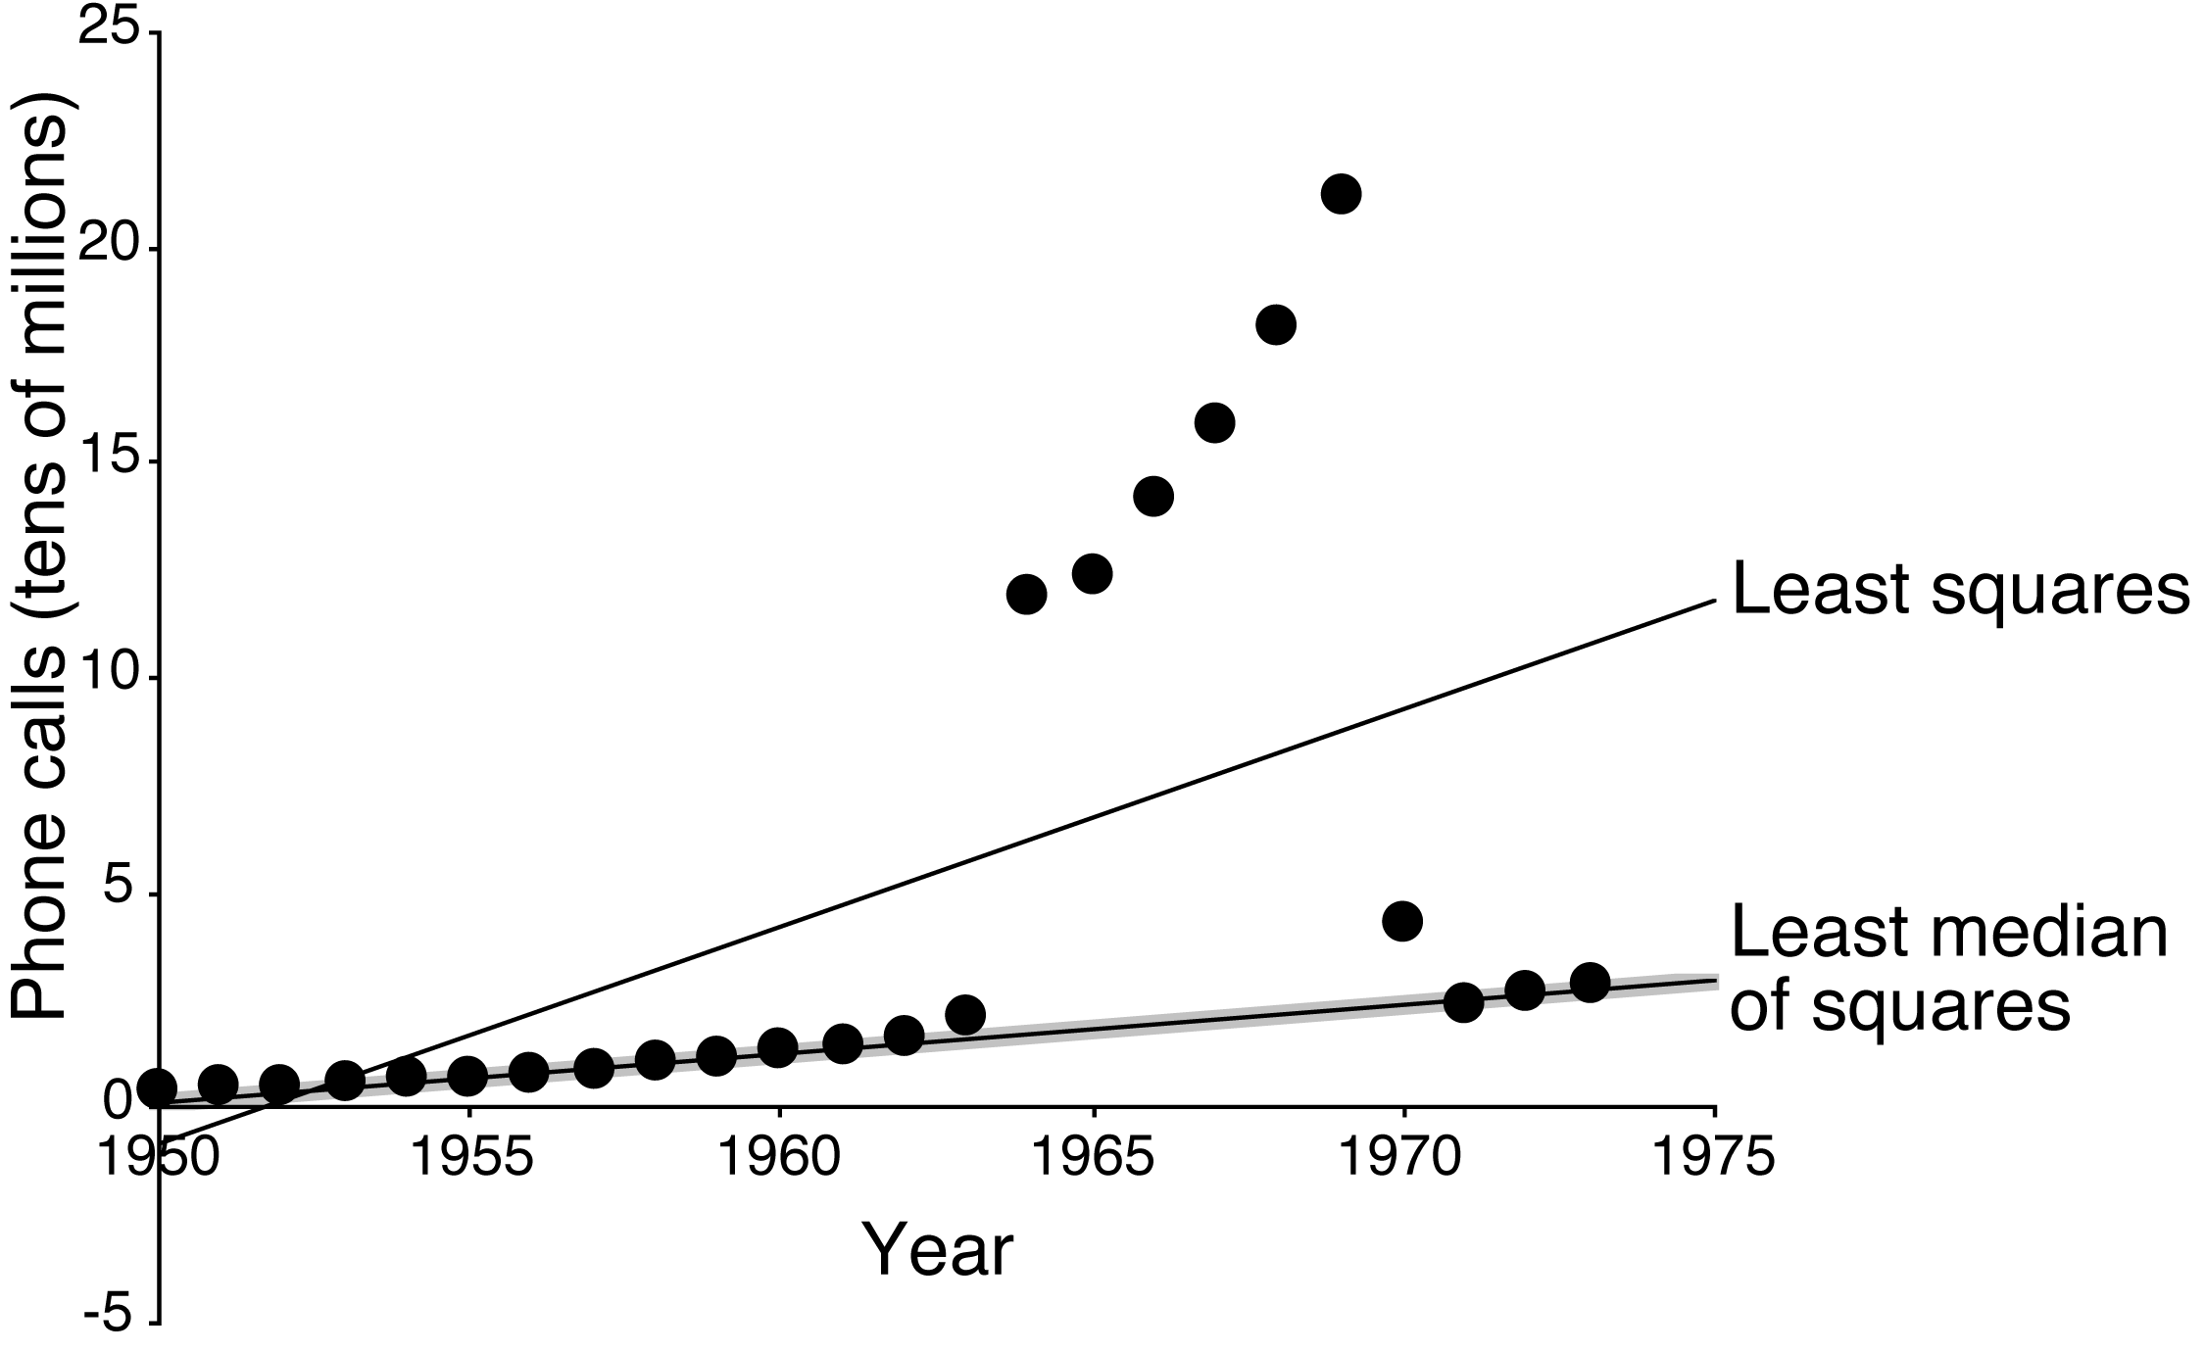
Example: least median of squares
Number of international phone calls from Belgium, 1950–1973

Slide 30
Detecting anomalies
Visualization can help to detect anomalies
Automatic approach:
committee of different learning schemes
  E.g.
    decision tree
    nearest-neighbor learner
    linear discriminant function
  Conservative approach: delete instances incorrectly classified by all of them
  Problem: might sacrifice instances of small classes

Slide 31
One-Class Learning
Usually training data is available for all classes
Some problems exhibit only a single class at training time
  Test instances may belong to this class or a new class not present at training time
One-class classification
  Predict either target or unknown
Some problems can be re-formulated into two-class ones
Other applications truly don't have negative data
  Eg password hardening

Slide 32
Outlier detection
One-class classification is often called outlier/novelty detection
Generic approach: identify outliers as instances that lie beyond distance d from percentage p of the training data
Alternatively, estimate density of the target class and mark low probability test instances as outliers
  Threshold can be adjusted to obtain a suitable rate of outliers

Slide 33
Generating artificial data
Another possibility is to generate artificial data for the outlier class
  Can then apply any off-the-shelf classifier
  Can tune rejection rate threshold if classifier produces probability estimates
Generate uniformly random data
  Too much will overwhelm the target class!
    Can be avoided if learning accurate probabilities rather than minimizing classification error
  Curse of dimensionality – as # attributes increase it becomes infeasible to generate enough data to get good coverage of the space

Slide 34
Generating artificial data
Generate data that is close to the target class
  No longer uniformly distributed and must take this distribution into account when computing membership scores for the one-class model
T – target class, A – artificial class. Want Pr[X | T], for any instance X; we know Pr[X | A]
Combine some amount of A with instances of T and use a class probability estimator to estimate Pr[T | X]; then by Bayes' rule:
For classification, choose a threshold to tune rejection rate
How to choose Pr[X | A]? Apply a density estimator to the target class and use resulting function to model the artificial class

Slide 35
Transforming multiple classes to binary ones
Some learning algorithms only work with two class problems
  Sophisticated multi-class variants exist in many cases but can be very slow or difficult to implement
A common alternative is to transform multi-class problems into multiple two-class ones
Simple methods
  Discriminate each class agains the union of the others – one-vs.-rest
  Build a classifier for every pair of classes – pairwise classification

Slide 36
Error-correcting output codes
Multiclass problem ⇒ binary problems
  Simple one-vs.rest scheme:
  One-per-class coding
Idea: use error-correcting
codes instead
  base classifiers predict
  1011111, true class = ??
Use code words that have
large Hamming distance
between any pair
  Can correct up to (d – 1)/2 single-bit errors
class
class vector
a
1000
b
0100
c
0010
d
0001
class
class vector
a
1111111
b
0000111
c
0011001
d
0101010

Slide 37
More on ECOCs
Two criteria :
  Row separation:
  minimum distance between rows
  Column separation:
  minimum distance between columns
    (and columns’ complements)
    Why? Because if columns are identical, base classifiers will likely make the same errors
    Error-correction is weakened if errors are correlated
3 classes ⇒ only 2³ possible columns
  (and 4 out of the 8 are complements)
  Cannot achieve row and column separation
Only works for problems with > 3 classes

Slide 38
Exhaustive ECOCs
Exhaustive code for k classes:
  Columns comprise every
  possible k-string …
  … except for complements
  and all-zero/one strings
  Each code word contains
  2^{k–1} – 1 bits
Class 1: code word is all ones
Class 2: 2^{k–2} zeroes followed by 2^{k–2} –1 ones
Class i : alternating runs of 2^{k–i} 0s and 1s
  last run is one short
Exhaustive code, k = 4
class
class vector
a
1111111
b
0000111
c
0011001
d
0101010

Slide 39
More on ECOCs
More classes ⇒ exhaustive codes infeasible
  Number of columns increases exponentially
Random code words have good error-correcting properties on average!
There are sophisticated methods for generating ECOCs with just a few columns
ECOCs don’t work with NN classifier
  But: works if different attribute subsets are used to predict each output bit

Slide 40
Ensembles of nested dichotomies
ECOCs produce classifications, but what if we want class probability estimates as well?
  e.g. for cost-sensitive classification via minimum expected cost
Nested dichotomies
  Decomposes multi-class to binary
  Works with two-class classifiers that can produce class probability estimates
  Recursively split the full set of classes into smaller and smaller subsets, while splitting the full dataset of instances into subsets corresponding to these subsets of classes
    Yields a binary tree of classes called a nested dichotomy

Slide 41
Example
Full set of classes: [a, b, c, d]
Two disjoint subsets: [a, b] [c, d]
[a] [b] [c] [d]
Nested dichotomy as a code matrix:
Class | Class vector
a | 0 0 X
b | 1 X 0
c | 0 1 X
d | 1 X 1

Slide 42
Probability estimation
Suppose we want to compute Pr[a | x]?
  Learn two class models for each of the three internal nodes
  From the two-class model at the root:
    Pr[{a, b} | x]
  From the left-hand child of the root:
    Pr[{a} | x, {a | b}]
  Using the chain rule:
    Pr[{a} | x] = Pr[{a} | {a, b}, x] × Pr[{a, b} | x]
Issues
  Estimation errors for deep hierarchies
  How to decide on hierarchical decomposition of classes?

Slide 43
Ensembles of nested dichotomies
If there is no reason a priori to prefer any particular decomposition then use them all
  Impractical for any non-trivial number of classes
Consider a subset by taking a random sample of possible tree structures
  Caching of models (since a given two class problem may occur in multiple trees)
  Average probability estimates over the trees
  Experiments show that this approach yields accurate multiclass classifiers
  Can even improve the performance of methods that can already handle multiclass problems!

Slide 44
Calibrating class probabilities
Class probability estimation is harder than classification
  Classification error is minimized as long as the correct class is predicted with max probability
  Estimates that yield correct classification may be quite poor with respect to quadratic or informational loss
Often important to have accurate class probabilities
  e.g. cost-sensitive prediction using the minimum expected cost method

Slide 45
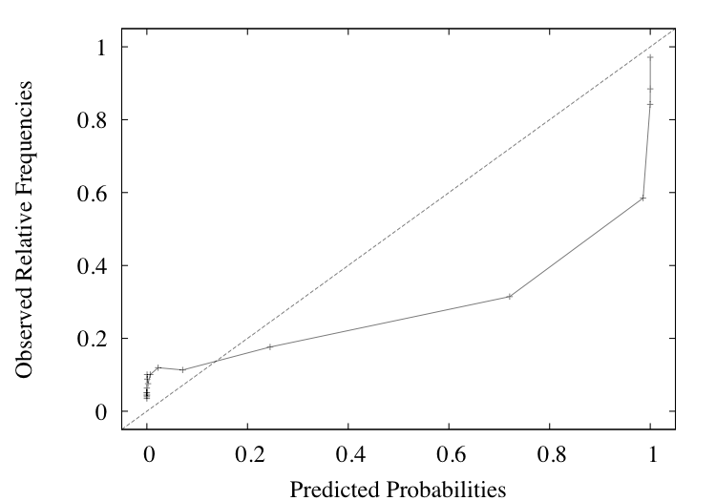
Calibrating class probabilities
Consider a two class problem. Probabilities that are correct for classification may be:
  Too optimistic – too close to either 0 or 1
  Too pessimistic – not close enough to 0 or 1
Reliability diagram showing overoptimistic probability estimation for a two-class problem

Slide 46
Calibrating class probabilities
Reliability diagram generated by collecting predicted probabilities and relative frequencies from a 10-fold cross-validation
  Predicted probabilities discretized into 20 ranges via equal-frequency discretization
  Correct bias by using post-hoc calibration to map observed curve to the diagonal
  A rough approach can use the data from the reliability diagram directly
Discretization-based calibration is fast...
  But determining the appropriate number of discretization intervals is not easy

Slide 47
Calibrating class probabilities
View as a function estimation problem
  One input – estimated class probability – and one output – the calibrated probability
Assuming the function is piecewise constant and monotonically increasing
  Isotonic regression minimizes the squared error between observed class “probabilities (0/1) and resulting calibrated class probabilities
  Alternatively, use logistic regression to estimate the calibration function
    Must use the log-odds of the estimated class probabilities as input
    Multiclass logistic regression can be used for calibration in the multiclass case

